Slide 1
Digital Safety
The positive and negative of digital communication.
By Jose Hernandez Lopez

Slide 2
Email
Positive: You can stay in touch with relatives and friends from a different state. It is faster than sending postcards and you can also share pictures through email.
Negative: You will not know if the person receiving your email is the person you are sending the mail to. Other people can hacked to your conversation. People live a less social life and they will lose the interaction with face to face conversation.

Slide 3
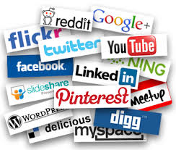
Social Media
Positive: You only post things that you are going through you do not have to be texting back every 2 minutes. It is easy and convenient and all of your friends will see it. It also helps you to keep in touch with friends.
Negative: Cyber bullying is one of the most common problems. The material you share will affect your career and life in the real world. Some companies will deny you the job if they see things they do not like in your social media. People live a less social life

Slide 4
Digital communication has its bad and good side. The good side is that you can stay in touch with all your relatives and it is faster. The postcards are way to slow and you will not be traveling when you need to see them or talk to them. Digital communication affects all people but by using it it may lead to cyber bullying which is one of the cases that a lot of teenager and people face through social media. One of the other crimes most seen today is identity fraud which hackers that hack your information do.

